Slide 1
NBFC – Foreclosure Prediction
Vikram Radhakrishnan

Slide 2
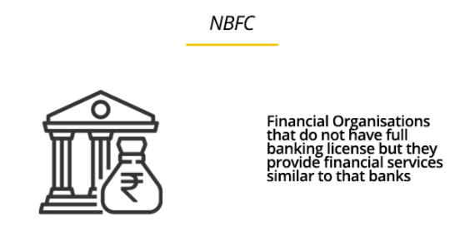
Business Problem
Foreclosure possibility check for loan approvals in NBFC (Non Banking Financial Companies)
Predict whether a new loan application can be disbursed to an applicant based on his application parameters and historical trend on the basis of previous records
Given – Dataset with aggregate past loan allotment records with multiple features/parameters. Also contains information on whether those loans defaulted or not. Current dataset has around 22000 records with close to 50 fields/features, with both static and dynamic data

Slide 3




Business Problem - Use of Analytics
Why Analytics/AI/ML?
Automate the process of prediction of loan defaults. Ability to rapidly update model quickly based on recent transactions
Disbursal or rejection with higher confidence and accuracy based on patterns of historical transactions leading to reduction in losses due to foreclosure
Faster processing rates to remain competitive and customer friendly
Automation
Accuracy
Faster Processing
Higher returns for NBFC

Slide 4
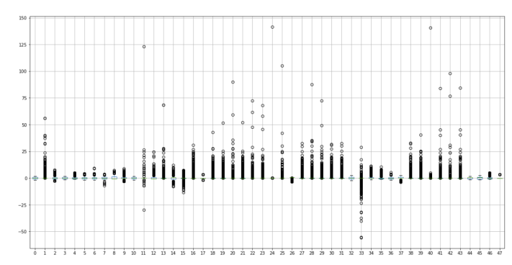
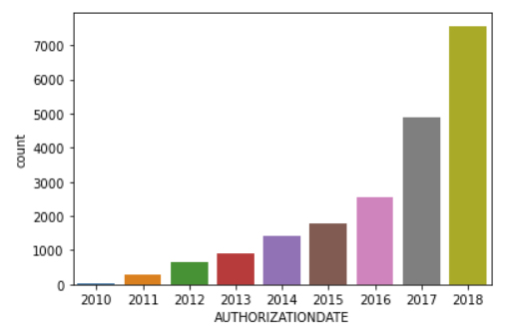
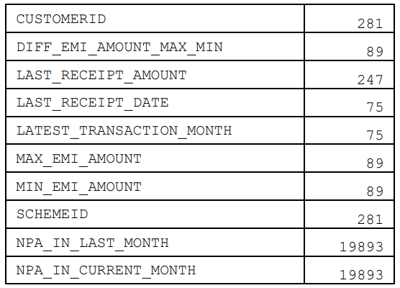
EDA and Data Preparation
Understanding and Pre-Processing data:
Descriptive Modelling and Exploratory data analysis (EDA)
Understanding features, removing unwanted columns, renaming as appropriate
Check for null values or missing values and take appropriate action
Outlier detection, Scaling the data – Standard or Z scaler is used
Outlier Treatment – 1.5 IQR technique (on either side) is used to adjust the outliers
EDA – Loans authorization over years
Plotting Outliers
Null value detection in features

Slide 5



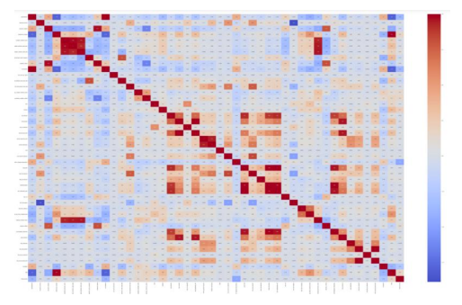
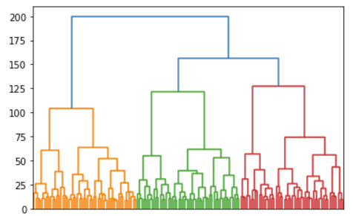
EDA and Data Preparation
Understanding and Pre-Processing data:
Descriptive Modelling and Exploratory data analysis (EDA)
Variable Transformation – Convert categorical variables to numeric through label encoding
Clustering data in groups for general understanding
Correlation map between features(heatmap), Feature importance ranking
Checking Class Balance to see if oversampling/undersampling req. Not necessary in this case
Label Encoding
Class Balance Checking
Clustering
Correlation heatmap

Slide 6
Modelling Approach
Approach
Supervised learning where independent variables are used to predict a dependent variable (Foreclosure)
We model this as a Classification problem where we predict a class label (0 or 1), to predict whether the loan will stay ‘status-quo’ or ‘default’
Feature Engineering
Identification (through heatmap) and removal of highly correlated features
We employ Sci-kit learn’s feature importance ranking and choose 15 features from the list. Care is taken that these features are understood while picking them (for example, loan ID may rank high, but is not important for modeling).
Alternatively, other methods such as PCA or Chi-square tests can be used to do feature selection and removal.

Slide 7
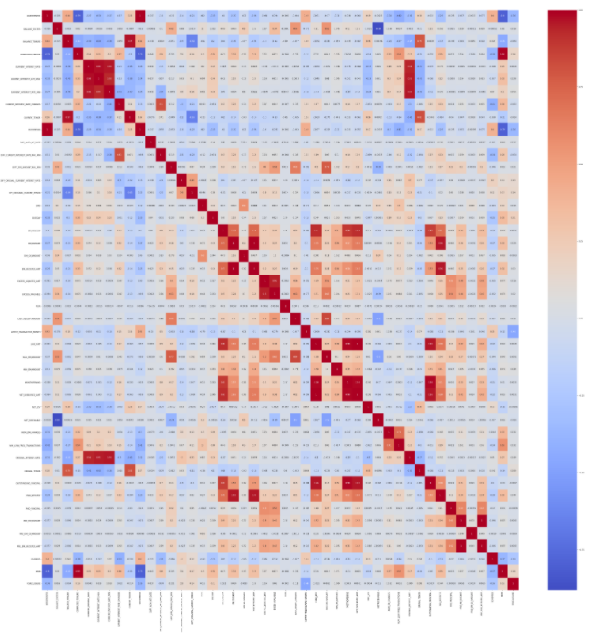
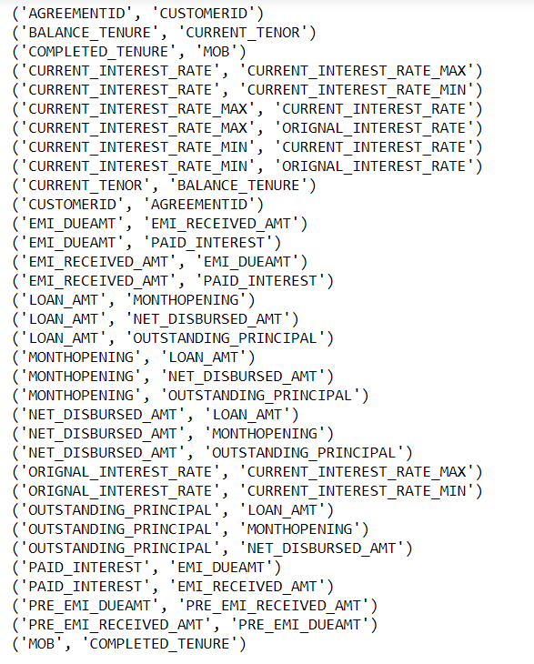
Modeling Approach
Correlation > 0.95

Slide 8
Machine Learning Model
Building the ML model :
The data is split into training and test data in a 80:20 ratio. This is agreeable since we have sufficient records.
Various classification algorithms are experimented on this data :
CLASSIC MODELS
1. Decision Trees (CART)
2. Logistic Regression (Logit)
3. Linear Discriminant Analysis (LDA)
4. Support Vector Machine (SVM)
5. Artificial Neural Networks (ANN)
6. Gauss Naïve Bayes (NB)
7. K Nearest Neigbour (KNN)
ADVANCED MODELS
Random Forest (with tuning)
Bagging (with RF)
Boosting (XGBoost)

Slide 9
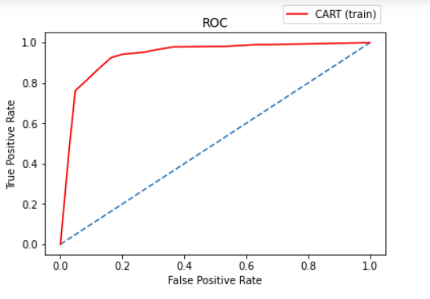
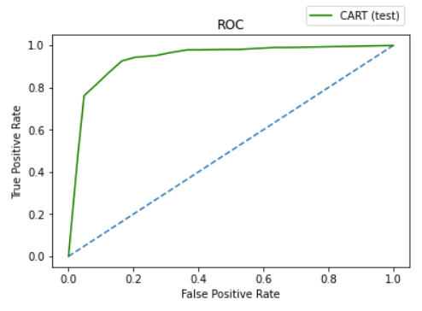

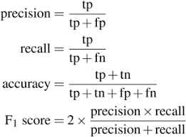
Metrics
Classification Metrics used:
Accuracy
Recall
Precision
Support
F1 Score
ROC (Receiver operating Characteristics)
AUC (Area under Curve)
ROC curve for Decision Trees (CART)
Area Under Curve (CART) : Train & Test

Slide 10
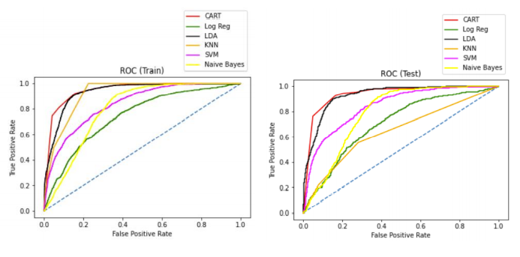
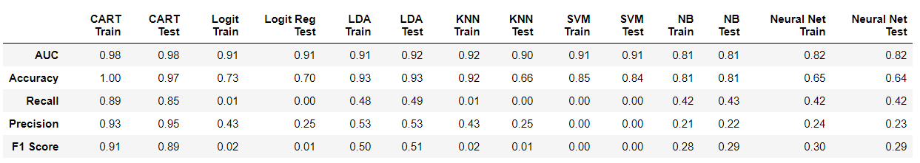
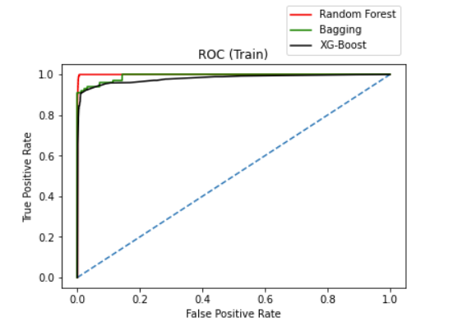
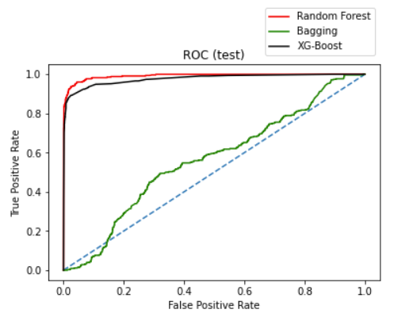
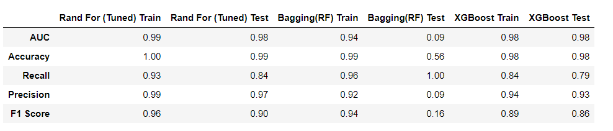
Metrics
METRICS - CLASSIC MODELS
METRICS – ADVANCED MODELS

Slide 11
Observations on Metrics
Some algorithms, such as SVM perform better with balanced data after using SMOTE. We do not use SMOTE for other models, because the data is sufficiently balanced (~10% foreclosures in data). SMOTE is usually applied when one class is around 1-2% of the total data. We do not use most of the models tried here because of insufficient value of metrics.
Precision and Recall :
In this study, we prefer that the prediction leads us to reject a loan assuming foreclosure (even it’s a wrong prediction) than clearing a loan application. With classification problems such as this, where False Negatives are a lot more expensive than False Positives, we prefer a model with a high recall rather than high precision.
CART performs well. Ensemble models such as Random Forest and XG-Boost perform the best when looking at all metrics overall. We can go for XG-Boost to reduce risk of overfitting

Slide 12
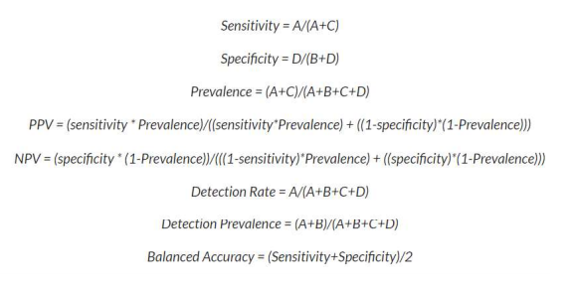
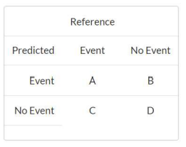
APPENDIX

Slide 13
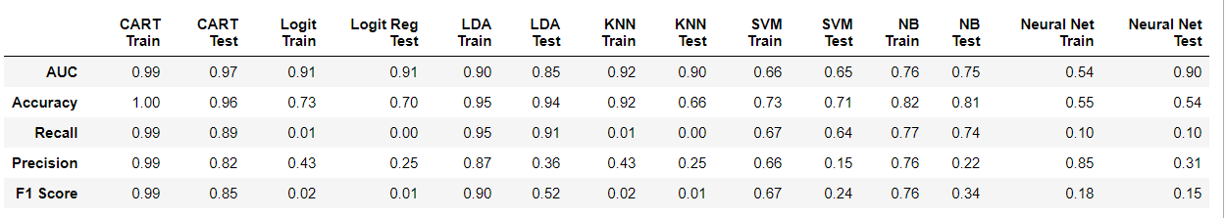
Appendix: SMOTE on data
Without SMOTE
With SMOTE

Slide 14
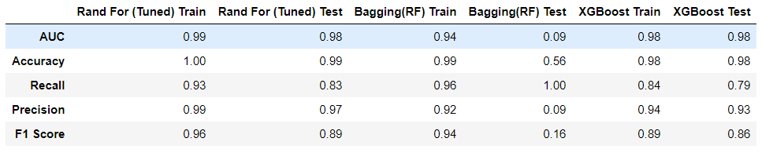
Appendix: SMOTE on data
Without SMOTE
With SMOTE

Slide 15
Recommendations
<Tentative time – 2.5 mins>

